Slide 1
Resident Research 2023-2024
Andrew P. DeFilippis, MD
APD for Research

Slide 2
Why do Research During Residency?
Gain exposure to a new experience
Opportunity to work independently on a project that is of interest to you
Participating in Scholarly Activity (ACGME requirement)
Enhance your fellowship application
  Having a research product
  Strong recommendation letter from your mentor
  Present at a national meeting
Unique contribution to the world

Slide 3
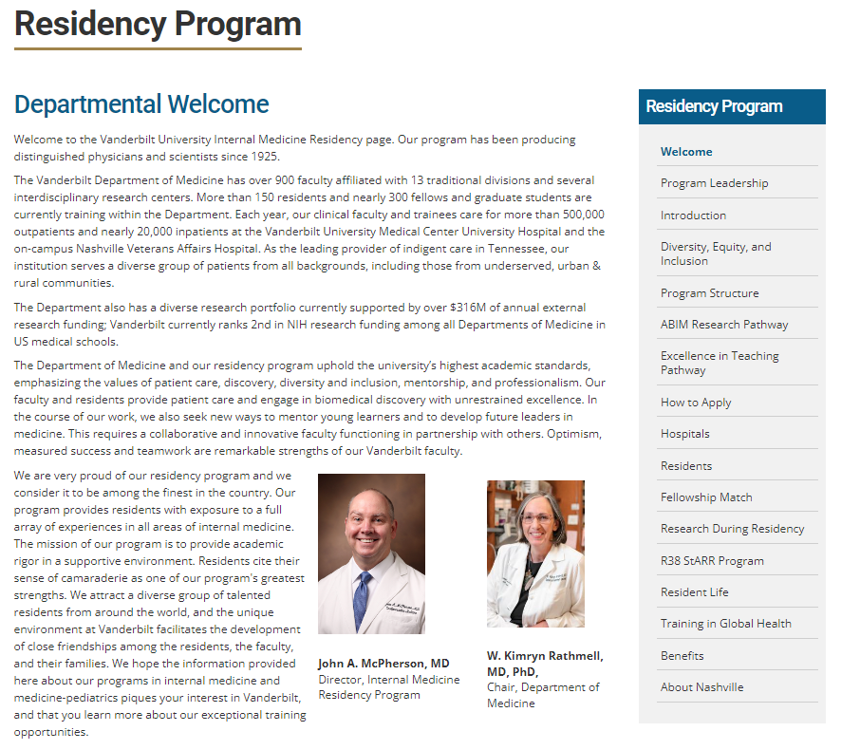

Slide 4
Key steps to get started
Admin Day (Q 6wks):
Go to the Research During Residency web page and email one or more Resident Research Liaisons to arrange meetings to discuss your research interests
1
Admin Day (Q 6wks):
Meet with Resident Research Liaison(s) 1 month or more prior to Research Clinic Block to help identify potential research mentors
2
Admin Day (Q 6wks):
Set up meeting with one or more potential research mentors (suggested by liaison) during your Intern Year Research Clinic; email 2-4 weeks before research clinic
3
Research Clinic (2 wk block):
• Research Mentor Meeting(s)
• Identify Research Topic
• Identify Topic Specific Resources
• Identify target conference and submission deadlines
4

Slide 5

Resident Research Liaisons
Current Liaisons
Division/Department | Liaison
Biomedical Informatics | TBA
Cardiology | Jonathan Brown
Clinical Pharmacology | Matt Luther
Endocrinology | John Stafford
Epidemiology/Public Health | TBA
Gastroenterology | Dhyanesh (Dan) Patel
General Medicine | Christianne Roumie
Genetics | Doug Ruderfer
Geriatrics | TBA
Hematology | Brent Ferrell
Infectious Diseases | Jessica Castilho
Medical Education | Cody Chastain
Nephrology | Eddie Siew
Oncology | Doug Johnson
Pulmonary | Julie Bastarache
Quality Improvement | Jill Jones
Rheumatology | Amy Major
Health Services Research | Sunil Kripalani

Slide 6
Intern Year Research Road Map—Key concepts
Research Clinic (Fall)
Research Mentor Meeting(s)
Identify Research Topic
Identify Topic Specific Resources
Identify abstract deadline
Research Clinic (Spring)
Research mentor meeting(s)
IRB Submission
Secure data
Data analysis plan
July 1, 2023
Admin Day (Q 6wks)
Research Liaison Meeting(S)
Schedule Research Mentor Meetings
Admin Day (Q 6wks)
F/U Research Mentor Meetings
Review literature on your topic
Consistent work on project

Slide 7
Top Tips for Resident Research
Start Early. Know abstract deadlines.
Tackle a focused problem using existing databases
Be Proactive / Take ownership
Set realistic goals and expectations
Follow through / max 48 hour response time to requests
Plan ahead for abstract submissions
Use institutional resources
Utilize connections you make in clinic and on the wards
Submit all required documentation

Slide 8
How to Present your Work as a Resident
Finances
  Department of Medicine offers up to $1000 per academic year per resident to help fund conference attendance for accepted presentations
Logistics
  Look ahead at your schedule for conference dates as soon as you submit
  You are responsible to find and arrange shift coverage or request days off in advance
  The chiefs can help discuss strategies with you to figure out coverage

Slide 9
Thank You
andrew.defilippis@vumc.org

