Slide 1
Non Opioid Pain Management
Martha Leonard

Slide 2
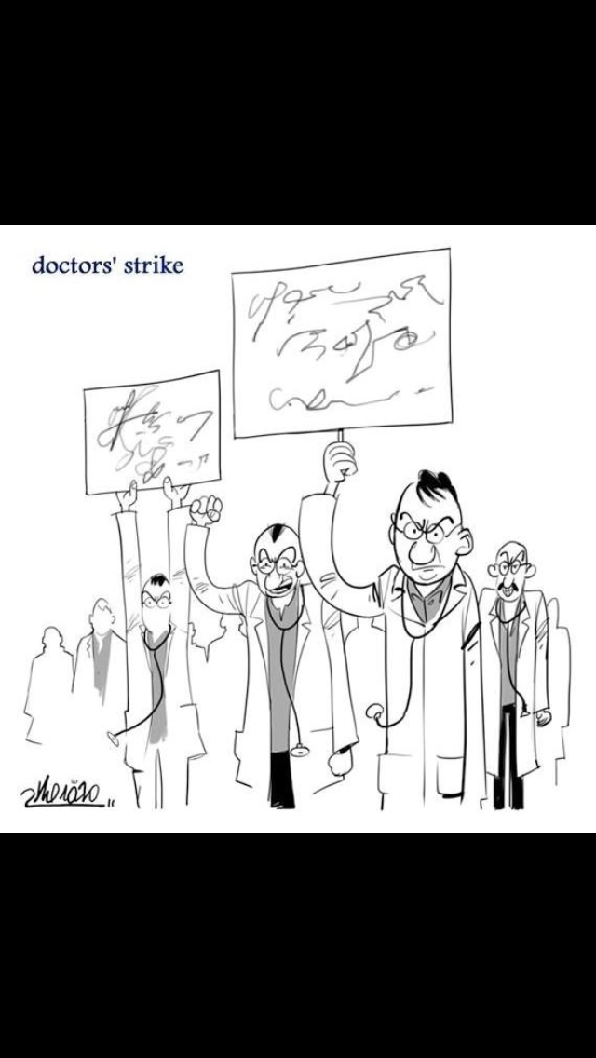
Opioid Epidemic
Physicians are now in a catch 22- needing to manage chronic pain in patients previously treated with opioids, but now encouraged to NOT use opioids.
This will require an approach with a strong knowledge base in non opioid analgesic medications.

Slide 3
Nature of Pain
Total Pain
Physical
Mental
Emotional
Spiritual
Unpleasant sensory and emotional experience
Subjective
Palliative care providers consider pain as total pain

Slide 4
Anatomy and Physiology of Nociception and Analgesia
Activation by mechanical, thermal, and chemical injury
Nerve fibers classified as A, B, and C fibers with alpha, beta, delta, and gamma subcategories
A Delta fibers respond to pricking, squeezing, and pinching and lead to the “fast, sharp” pain
Polymodal C fibers respond to many noxious stimuli and produce slow, throbbing, and more diffuse pain
Descending inhibitory neural pathways from the brain to the spinal cord involve serotonin and norepinephrine

Slide 5
Types of Pain
Acute versus Chronic
Nociceptive versus Neuropathic
Somatic versus Visceral
Cancer versus Non-Cancer
Knowing the type of pain, the location, and severity will guide the therapy needed.

Slide 6
Four Step Analgesic Ladder
Non opioid, adjuvant analgesics
Moderate opioid, adjuvant analgesic, non opioid
Strong Opioid, adjuvant analgesic,non
opioid
Interventional Anesthetic pain therapies

Slide 7
Non Opioid Analgesic Management
NSAIDS
Acetylsalicylic acid (ASA)
Paracetamol (acetaminophen)
Corticosteroids
Adjuvant analgesics or what is now called co-analgesics
Interventional pain modalities
Including acupuncture, TENs unit, counseling, PT/OT, and other non- pharmacological interventions

Slide 8
NSAIDS indications
Pain due to bony metastases
Inflammatory pain (pleuritic chest pain, pericarditis)
Musculoskeletal pain
Soft tissue injuries, dysmenorrhea, dental pain, Headache

Slide 9
NSAIDS mechanism and types
NSAIDs inhibit
COX-1
Constitutive
COX-2
Inducible @ sites of inflammation
Work by inhibiting the enzyme cyclooxygenase (COX) and that prevents the production of prostaglandins
Two types of COX, constitutive (COX-1) and inducible form (COX-2)

Slide 10
NSAIDS
Non selective Cox-1 + Cox 2
Ibuprofen
Naproxen
Diclofenac
Indomethacin
Meloxicam
Selective Cox -2
Celecoxib
Valdecoxib
Etoricoxib

Slide 11

Which Route for NSAIDs
Oral-most common
IV useful in hospital settings (ketorolac)
Topical (diclofenac or Voltaren gel)

Slide 12
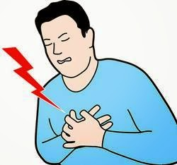
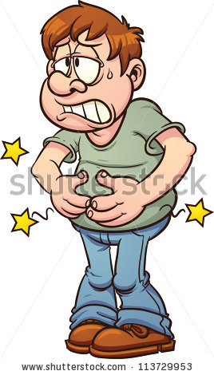
Adverse events and side effects with NSAIDs

Slide 13
Side Effects/Complications/Contraindications of NSAIDS
Where | What
GI tract | Pain, Nausea, Gastric erosion and ulceration, GI bleedings, perforation (up to 20% of patients will develop this side effect) Celebrex best, followed by Naproxen and ibuprofen
Kidney | Water and sodium retention, edema, hyperkalemia, decreased efficacy of antihypertensive medications and diuretics (sulindac considered more safe)
CNS | HA, confusion, vertigo, depression, dizziness
Platelets | Inhibition of activation, increased risk of bleeding (Risk continues for 2 days after discontinuation of NSAIDS and 7 days after ASA discontinued)
Other-Hypersensitivity | Rhinitis, Bronchial Asthma, Urticaria, Flushing, Hypotension, Shock and hepatoxicity

Slide 14
Cardiovascular toxicity of NSAIDS
Naproxen thought to have less risk for this
Absolute risk is small (2 events per 1000 persons per year in patients with low risk and 7 to 8 per 1000 persons per year , including 2 fatal events in persons with high risk)
Risk worse when NSAIDs thought to impact blood pressure as well as pro-thrombotic effects

Slide 15
GI toxicity
Guidelines for risk stratification—
History of ulcer or GI hemorrhage
Age>60 (increased risk 5 to 6 times)
High dose of the NSAID, which increases risk 10 fold
Concurrent use of glucocorticoids
Concurrent use of anticoagulants
High Risk: history of previous complicated ulcer or 2 or more of risks (rec not using)
Moderate Risk: 1 or 2 risk factors
Rec using low dose and with PPI
Low Risk: no risk factors, okay to use without PPI

Slide 16
NSAIDs take home points
Useful for bone pain and inflammation, not as useful for neuropathic pain
Relative contraindication in patients at high risk for peptic ulcer disease (advanced age, history of PUD or prior NSAID gastroduodenopathy, advanced illness, concurrent corticosteroids use)
Relative contraindication in patients with CV disease or hypercoagulability
Contraindicated in renal disease, multiple myeloma, or low perfusion states
Naproxen thought to be less likely to increase risk of CV events
Celebrex, then ibuprofen or naproxen less likely to cause GI toxicity
Potency of maximum doses of NSAIDs equivalent to 5 to 10mg IV morphine in studies

Slide 17
Cases for NSAIDs-why or why not
60 yo female with ovarian cancer and bowel obstruction w/ history of PUD
55 yo male with ischemic cardiomyopathy with comorbid gout and osteoarthritis presents w/ knee pain
64 yo male with newly diagnosed glioblastoma multiforme currently on corticosteroids
67 yo female with metastatic breast cancer with bone metastasis and brain metastasis w/ comorbid CKD
55 yo male with PMHx of PUD presenting with newly diagnosed prostate cancer with bone metastasis

Slide 18
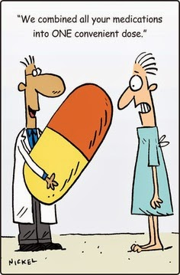
Acetaminophen
Analgesic and antipyretic, not considered an anti-inflammatory
Mechanism is poorly understood
Used in various combination products
Preferred over NSAIDs for pediatric and elderly patients

Slide 19
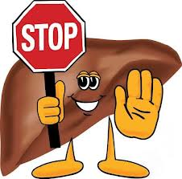
Acetaminophen
Hepatotoxicity is greatest concern with Acetaminophen
Suggested maximal dose of 650mg and maximal total dose of 3 grams or less in a 24 hour period
No more than 325mg in combination opioid/APAP drugs

Slide 20
Cases for Tylenol-why or why not
60 yo female with ovarian cancer and bowel obstruction with escalating pain requiring more frequent Lortab for pain
55 yo male with ischemic cardiomyopathy with comorbid gout and osteoarthritis
64 yo male with newly diagnosed glioblastoma multiforme with comorbid cirrhosis
67 yo female with metastatic breast cancer with bone metastasis and brain metastasis with current etoh abuse disorder
55 yo male with PMHx of PUD presenting with newly diagnosed prostate cancer with bone metastasis

Slide 21
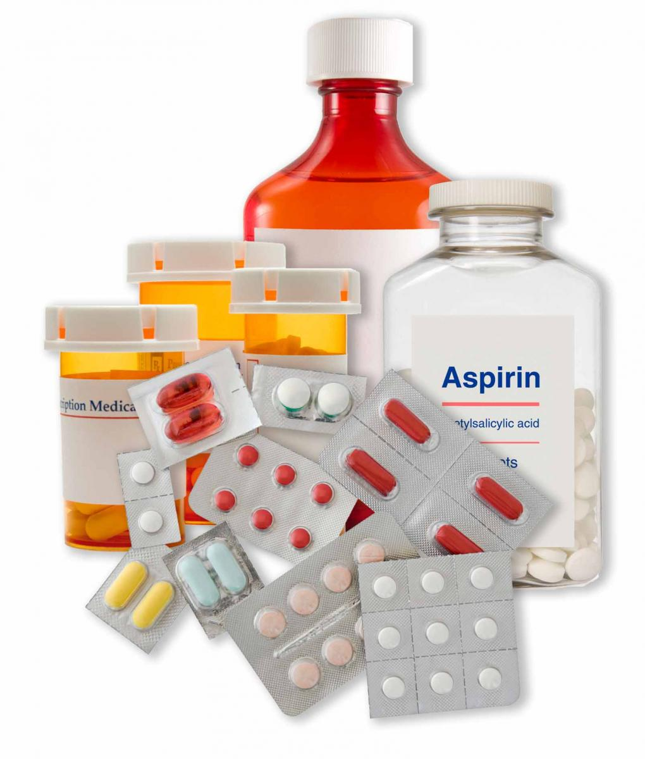
Adjuvant Analgesics
A drug that has a primary indication other than pain, but is analgesic in some painful conditions
Sometimes called “co-analgesic”

Slide 22
Adjuvant Analgesics/ Co-analgesics
Multipurpose | Neuropathic pain | Topical | Bone Pain | Bowel obstruction | Musculo-skeletal/Misc
Antidepressants | Anticonvulsants | Capsaicin | Calcitonin | Octreotide | Muscle relaxants
Corticosteroids | Sodium Channel Blockers | Local anesthetics | Bisphosphonate | Anticholinergics | Psychostimulant
Alpha-2 adrenergic agonists | N-Methyl-D Aspartate Receptor blockers | NSAIDS | Radio- pharmaceuticals | Corticosteroids
Neuroleptics | Cannabinoids |  | NSAIDs and corticosteroids
 | Misc. (baclofen, calcitonin)

Slide 23
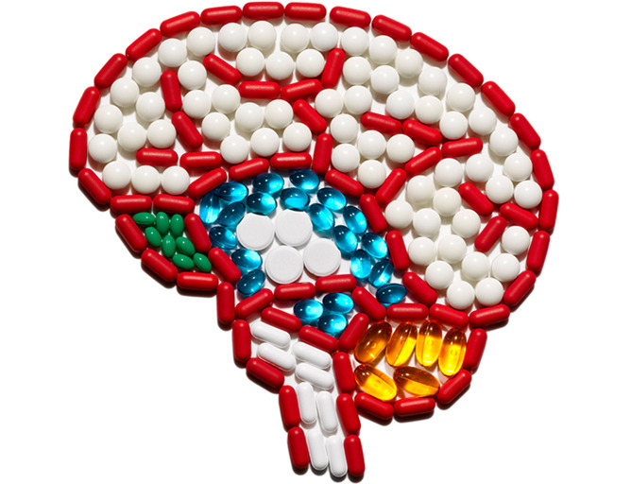
Antidepressants

Slide 24
Analgesic Antidepressants
Used primarily for neuropathic pain, sometimes in chronic pain
Mechanism based on enhanced availability of monoamines at synapses within the descending inhibiting pain modulating nervous system
Best established with SNRIs and TCAs (bupropion and SSRI used less)
Preferred SNRI is duloxetine, preferred TCA is nortriptyline or despiramine
Benefit of bupropion has been suggested in some studies and is more activating (but contraindicated with history of seizures)
First line without depression→ gabapentin or pregabalin
First line with depression→ SNRIs or tricylics

Slide 25
Corticosteroids
Multipurpose medication-nausea, pain, anorexia, malaise/fatigue, pain
Pain uses related to neuropathic pain, bone pain, pain associated with capsular expansion or duct obstruction, bowel obstruction, or lymphedema, and HA associated with ICP
Decadron preferred due to longer half life (daily dosing possible) and relatively low mineralocorticoid effects
Decadron 1 to 2mg Po or IV BID starting (sometimes after loading dose of 10mg)– unless using for ICP or bowel obstruction
Long term risk with myopathy, immunocompromise, steroid induced diabetes, osteoporosis, and hypoadrenalism

Slide 26
Alpha-2 adrenergic agonists
Clonidine and tizanidine used
Clonidine can be given orally, transdermally, or intraspinally
Spinally administered more for neuropathic than nociceptive
Side effects→ dry mouth, hypotension (orthostatic), and somnulence

Slide 27
Anticonvulsants
Gabapentin and pregabalin act by binding to the alpha-2 delta protein modulator of the N type, gated calcium channel→ which then reduces calcium influx into the neuron, and lessens the likelihood of depolarization
No drug-drug interactions, not metabolized by the liver (unlike other anticonvulsants)
Gabapentin has a pharmacokinetic ceiling (usually 1800mg per day), pregabalin does not

Slide 28
Dosing of anticonvulsants
Gabapentin
Pregabalin
Start with 100 to 300mg daily and increase dose gradually every few days to max dosing of 3600mg per day
Start at 50mg to 75 mg daily in two divided doses and titrate to 150 to 300mg twice daily over 1 week

Slide 29
Bone Pain
Bisphosphonates | Calcitonin | Denosumab | Bone Targeted Radioisotopes | Corticosteroids and NSAIDS
Inhibit osteoclast activity, stimulate osteoblasts to produce osteoclast –inhibiting factor, and causing osteoclast apoptosis Renal function warnings Temporary flu like syndrome Hypocalcemia (VIT D deficient) Osteonecrosis of the jaw Typical dosing of zometa: 4mg IV Ibandronate has oral and IV forms | Conflicting evidence of efficacy | Inhibits osteoclast activity by targeting receptor activator of nuclear factor Kappa B ligand (RANKL) Compared to zoledronic acid Same side effects as bisphosphonates One advantage over zometa is quick infusion and lack of renal function impairment | Examples include strontium-89 and samarium-153 Provides a short lived radiation source to bisphosphonate molecule Usually limited in use as causes myelosupression (12 weeks after) Can cause a transitory pain flare immediately after (5 to 10% of patients) | Lack of evidence based literature for use of corticosteroids in pain

Slide 30
Cannabinoids
Derived from the cannabis plant, which contains over 400 compounds, including more than 60 cannabinoids.
Primary psychoactive cannabinoid is delta-9-tetrahydrocannabinol (THC, also known as dronabinol)
Mechanism is related to endogenous system that includes cannabinoid-like ligands (endocannabinoids) as well as multiple receptors in the CNS and periphery
Sativex =nabiximols (approved in Canada) is an oromucosal spray which includes THC and cannabidol, approved for neuropathic pain in MS and cancer
Nabilone is started at 0.5mg to 1mg qhs and titrated up to 3mg BID
THC (Dronabinol) is started at 2.5mg daily or twice daily
Side Effects: dizziness, somnulence, and dry mouth

Slide 31
Ketamine, NMDA receptor antagonist
N-methyl-D-aspartate receptor antagonist, Ketamine involved in the CNS (sensitization of the central neurons and the functioning of the opioid receptor and possible analgesic properties)
Used primarily in refractory pain (neuropathic suspected) at end of life
Extensive list of side effects, including delirium/hallucination and as such usually given with benzodiazepine or neuroleptic
Dose- 0.05 to 0.4mg/kg/h infusion after initial 0.1 to 0.5mg/kg bolus dose or IV burst doses 0.25 to 0.5mg/kg or oral doses 0.3 to 0.5mg/kg tid

Slide 32
Topical Agents
Capsaicin | Lidocaine patch or gel | EMLA | NSAIDs/other
Constituent of chili pepper Depletes substance P form afferent C fibers Available as cream or patch Used for focal areas of neuropathy or arthropathy Must use for several weeks/4 times a day | Lidocaine 5% patch Can use q 24 hours Patches expensive, may be less expensive to use gel Can cut patches and can apply up to 3 or 4 | Eutectic mixture of local anesthetics (1:1 mix of prilocaine and lignocaine Used to prevent pain at incision or puncture sites Short lived anesthetic that is expensive | Diclofenac patch 1.3% or 1% gel available Patch is applied BID Gel dose is 2 to 4 gm qid for 7 days Other- cream with tricylic (amitriptyline 2% with or without ketamine1%) for neuropathic pain with conflicting evidence Topical doxepin for pruritis

Slide 33
Bowel Obstruction Analgesics
Corticosteroids | Octreotide | Anticholinergics
Various dosing regimens have been recommended, tend to use decadron 4mg q6 or q 8hour Risk of perforation concerning Mechanism unknown, suspected to decrease edema surrounding tumors and obstruction | Mechanism is the inhibition of secretion of gastric, pancreatic, and intestinal secretions and reduced GI motility Usually dose 50 to 100mcg subcutaneously TID for short course (usually 3 to 5 days) | Scopolamine and Glycopyrrolate used primarily Decreases secretions and decreases GI motility as well

Slide 34
Acupuncture and TENS
Acupuncture
TENS
Very old procedure for pain management
In category with cupping, scarification, cauterization
Acupuncture releases multiple endogenous substances (Beta-endorphin, metenkephalin, and dynorphins which activate opioid receptors; releases serotonin and oxytocin, endogenous steroids. It also up regulates opioid gene production
Historically used, dating back to 2500 BC
Mechanism thought to be due to the “gate theory”, selective electrical stimulation of the certain nerves block the pain impulses to the brain

Slide 35
Generals…
60 yo female with ovarian cancer and bowel obstruction
55 yo male with ischemic cardiomyopathy with comorbid gout and osteoarthritis
64 yo male with newly diagnosed glioblastoma multiforme
67 yo female with metastatic breast cancer with bone metastasis and brain metastasis
55 yo male with PMHx of PUD presenting with newly diagnosed prostate cancer with bone metastasis

Slide 36
References
Section 10.1 The Management of Pain. IN: Hanks GW, Cherny N, Christakis NA, Fallon M, Stein K, Portenoy RK, eds. Oxford Textbook of Palliative Medicine, 4th edition. Oxford: Oxford University Press, 2010.
Part 8 Pain. IN: Bruera E, Higginson IJ, Ripamonti C, von Gunten C, eds. Textbook of Palliative Medicine. London: Edward Arnold Publishers Ltd, 2006.
Chapter 8 The Principles of Pain Management. IN: Faull C, Yvonne C, Daniels L, eds. Handbook of Palliative Care, 2nd edition. Oxford: Blackwell Publishing Ltd, 2005.
Up to Date Topic: Cancer Pain management: Use of Acetaminophen and Nonsteroidal anti-inflammatory drugs. Portenoy RK, Ahmd E, Keilson YY Authors. Abrahm J, Savarese D, eds.
Up to Date Topic: NSAIDS: Therapeutic Use and Variability of Response in Adults. Solomon D, Author. Furst DE, Romain PL, eds.

